Slide 1
ALY 6060
Week 2: Data Analytics Culture within an Organization

Slide 2

Objectives
Explain how analyzing and displaying data in an analytics-driven culture is providing support to organizations to make good decisions with their data.
Define and describe the role of data scientist or data analyst in organizational decision making

Slide 3
Review Readings
Getting decision right right: How effective organizational decision-making can boost performance
Role of Data Science in strategy and decision making
Decision-Making: The impact of organizational culture

Slide 4
Readings Assigned to Each Student
READINGS | ASSIGNED STUDENTS
Getting decision rights right: How effective organizational decision-making can boos performance | Abbu, Parveen Amarnani, Kajal Ambasana, Vasu Rakesh Cao, Zeying Carro Prieto, Andrea Chen, Yujian Kuche, Anurag Kumar, Nishank Li, Yisheng Sethia, Saurabh Shah, Dhruvin Rakesh Shi, Yunshan Xu, Chenqi Yakkali, Sashank Zhai, Binyu
Role of Data Science in strategy and decision making | Patam, Charan Kumar Pawar, Shruti Avinash Premi, Pranshu Kumar Ravichandran, Rishi Prasana Sen, Tuhena Sethia, Barkha Prakash
Decision-Making: The impact of organizational culture | Sun, Jian Thota, Sunil Raj Wagner, Andres Wu, Shanglin Xiao, Yao Xie, Jifei

Slide 5
Instructions
Identify
Identify a quote from the article that you were assigned that represents an essential point/concept about data culture for a data professional
Go
Go to Jamboard: https://jamboard.google.com/d/1Z1f30-YAGqXXHsoWCraxohWhF05gYGGXeKPEkjo-2n0/edit?usp=sharing
Navigate
Navigate to the Jamboard page for your article
Create
Create a new sticky note
Write your name
Type in the quote from your article, along with the page # (if applicable)
NO DUPLICATES!!
You have 15 minutes to do this.

Slide 6
In Randomly Assigned Groups:
Identify
Identify which reading you were assigned
Read
Read your quote
Explain
Explain why you chose it and why it represents an essential point/concept about data culture for a data professional.
How should a data professional use this information or concept?

Slide 7
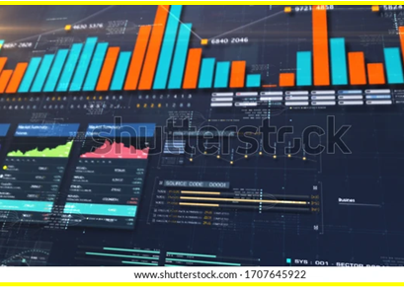
Data-drive culture
Goes beyond numbers, analysis, and charts.
It’s about reconfiguring your decision-making approach to align with fundamental business processes.
Every department should be connected to the data.

Slide 8
Improving an organization’s data-driven culture
The data needs to be made available and regarded as the primary tool for daily decision-making by the entire organization.
Being transparent with your analytic insights can shape data across the organization.
Data literacy across the organization is needed: the ability to read, understand, create, and communicate data as information
Knowing the right ways to analyze and prepare guidance resulting from the data can build commitment with stakeholders.
The organization needs to be open to learning and adapting based on what the numbers tell them, vs assumption decision-making.

Slide 9
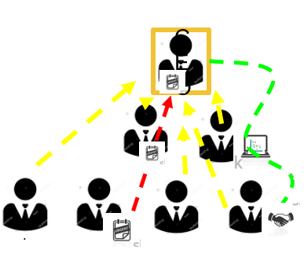
Upstreaming
Upstreaming is the flow of resources or information or data from the lower-level employees up through to the CEO.
Upstreaming drives the organization to ensure root cause analysis, identify and resolve issues and/or mitigate risks at that point.

Slide 10
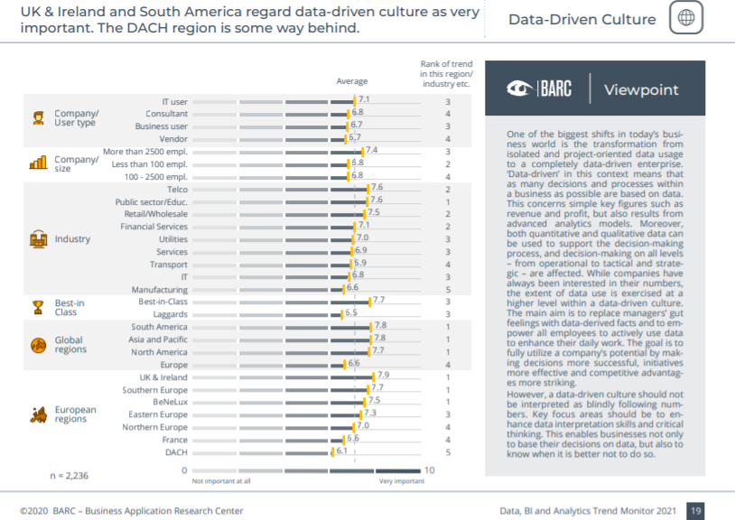
Data, BI and Analytics Trend Monitor 2021

Slide 11
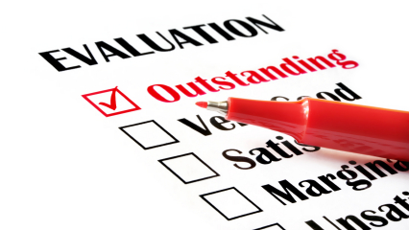
Assessing and understanding the culture is key
Culture throughout organizations may vary, so the key is learning about the existing culture within the organization you work for before making data decisions or recommendations.
It is essential to be aware of the culture as it drives processes, decisions, organizational structure, and other factors.
As a person working within the data analysis team, you must know the culture and how it impacts data and your role within the organization.
This Photo by Unknown Author is licensed under CC BY-NC-ND

Slide 12

How can one assess an organization's data analytics culture?
ⓘ Start presenting to display the poll results on this slide.

Slide 13
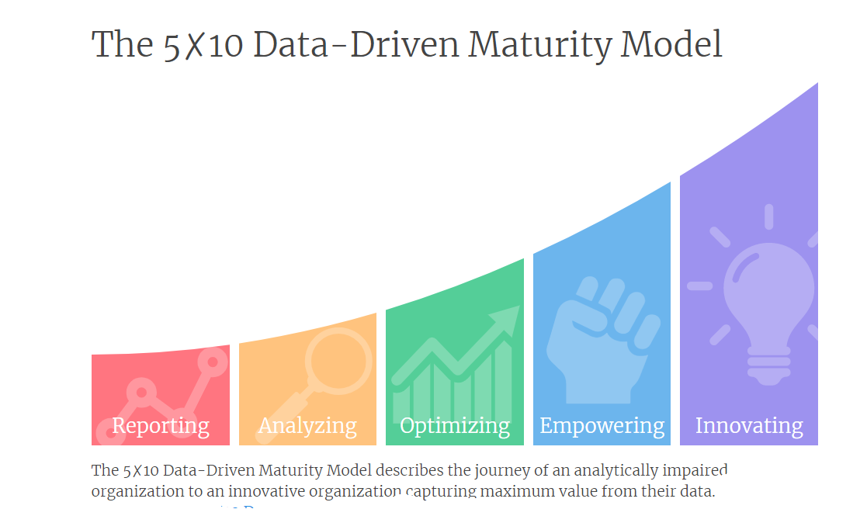
https://data-driven.rubenbuitelaar.com/model#:~:text=The%20accompanying%205%E2%9C%9710,5%20stages%20by%2010%20dimensions

Slide 14
5 stages of data-driven maturity
Reporting
Visualize existing data and create the foundation for an analytical future.
Analyzing
Dive deeper into the data to achieve insight into why things happened.
Optimizing
Optimize business processes by bringing analytical insight to operations.
Empowering
Empower employees by providing the tools and knowledge to perform analytical activities.
Innovating
Use data and experiments to innovate in products and transform the organization.
https://data-driven.rubenbuitelaar.com/model#:~:text=The%20accompanying%205%E2%9C%9710,5%20stages%20by%2010%20dimensions

Slide 15
Are you currently working for or have you ever worked for a business or organization?
ⓘ Start presenting to display the poll results on this slide.

Slide 16
Reflect on this organization. What level of data-driven maturity do you think it is/was? (Check one below.)
ⓘ Start presenting to display the poll results on this slide.

Slide 17

Reflect on This Organization
On what do you base your judgment?

Slide 18
10 dimensions of data-driven maturity
Data
Metrics
Skills
Technology
Leadership
Culture
Strategy
Agility
Integration
Empowerment

Slide 19
Assess the data-driven maturity of an organization you know
Think of the organization you currently work for an organization with which you have been associated in the past.
Evaluate that organization’s data-driven culture by completing the ✗10 Data-Driven Maturity Assessment at https://data-driven.rubenbuitelaar.com/assessment/general
The goal of the assessment is to gain insight into the data-driven maturity level of your organization in a fast and accessible manner.
After the assessment a report will be compiled with the results and information tailored to your maturity situation.

Slide 20

Discuss
How similar were your initial judgments and the result of the assessment?
What did this assessment teach you?
What surprised you about the content or formats of the results?
In what ways would the information contained in the results be useful to a data professional?

Slide 21
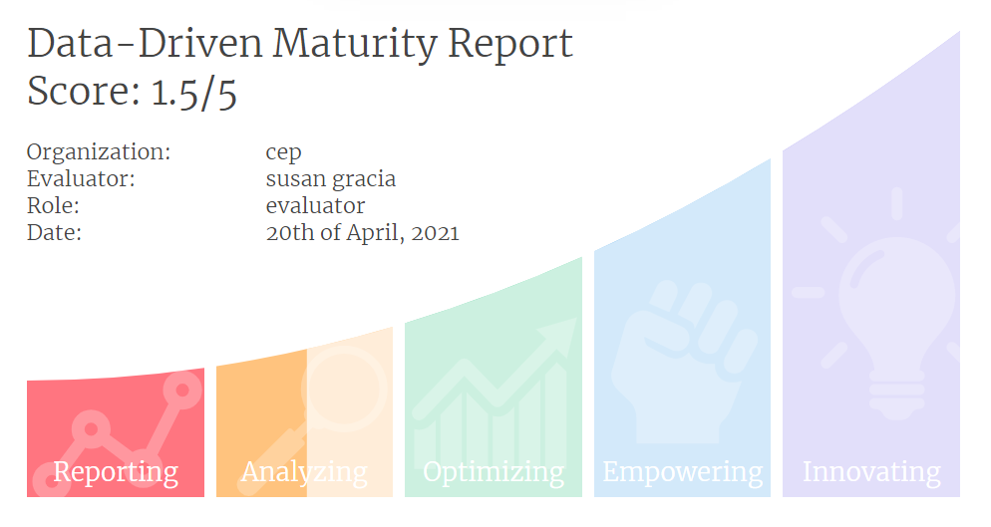
Results

Slide 22
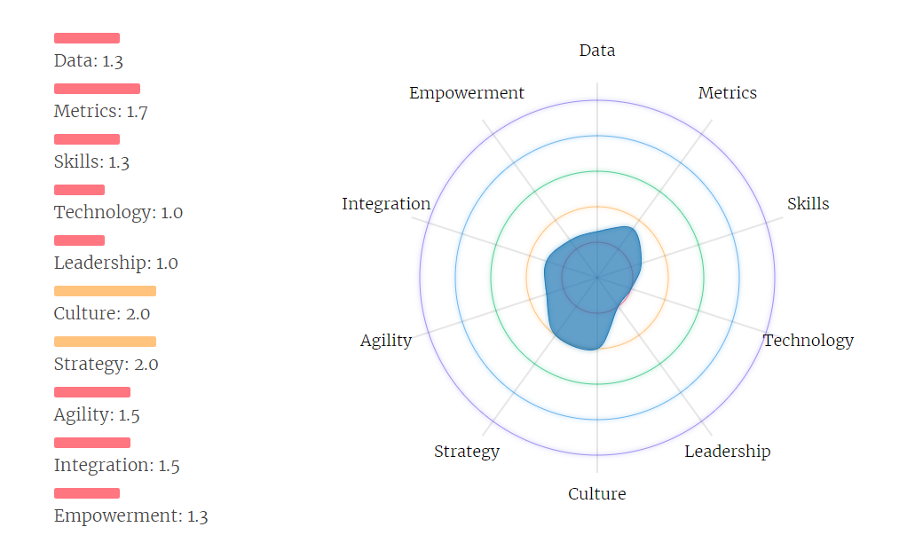
Results

Slide 23
Results
Recommendations for improving the data culture
Sample:
https://data-driven.rubenbuitelaar.com/assessment/report?id=ff2bffc0-a202-11eb-a4f7-8b33bb40e893

Slide 24
You have learned about and discussed data analytics culture and strategies that can increase data-driven maturity. How can you apply this to your own work as a data professional? What strategies will/can you use?
ⓘ Start presenting to display the poll results on this slide.

Slide 25
Week 2 Homework
Stakeholders on an assignment have a vested interest in its outcome, and usually those outcomes are aligned with a business goal. Analytics assignment stakeholders in particular often have to use data to present recommendations directly to an executive or leadership official which means that as a data analyst it's critical that you maintain continuous stakeholder involvement and commitment. Write a report answering the following questions:
What are some strategies you can use to help maintain the stakeholders’ commitment and involvement throughout an assignment's duration?
What might be some negative consequences of low stakeholder involvement?

